Slide 1
Forest Fire Real-Time Monitoring System
Course Module:EC6020
Group Number: Group 09
Group Members:
2022E002
2022E006
2022E062
2022E070
2020E102

Slide 2
Introduction
Forest fires cause severe damage to forests, wildlife, and human life
Early fire detection is essential to minimize destruction
Manual monitoring is not effective for large forest areas
An automated and real-time monitoring system is required

Slide 3
Problem Statement
Forest areas are often remote and lack network connectivity
Traditional fire detection systems are expensive and power-hungry
Delayed fire detection leads to uncontrollable fire spread
Limited real-time monitoring solutions for wide forest coverage

Slide 4
Proposed Solution
Automated forest fire monitoring using sensor nodes
Uses temperature, humidity, and smoke sensors
Data transmitted wirelessly using LoRa technology
Real-time alerts sent to a central monitoring system

Slide 5
System Objectives
Detect early signs of forest fires
Monitor environmental conditions continuously
Enable long-range communication with low power consumption
Provide real-time data visualization and alerts

Slide 6
System Overview
Sensor nodes deployed in forest areas
Each node monitors temperature, humidity, smoke, and location
Data transmitted to a LoRa gateway
Gateway forwards data to cloud/dashboard

Slide 7
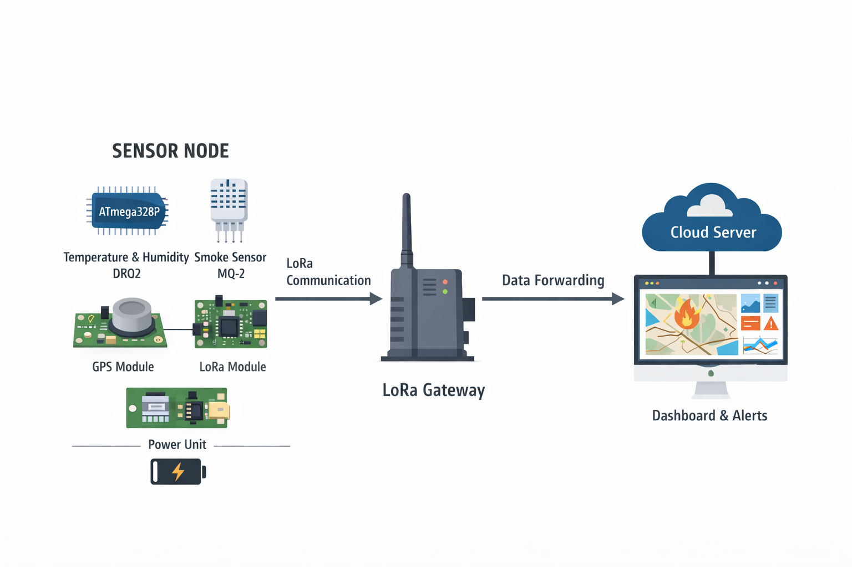
System Architecture
ATmega328P acts as the main controller
Sensors connected via ADC and digital pins
GPS module provides latitude and longitude
LoRa module transmits data wirelessly

Slide 8
Hardware Components
ATmega328 Microcontroller
DHT22 (Temperature & Humidity Sensor)
MQ-2 Smoke/Gas Sensor
LoRa Module (SX1278 / RFM95)
GPS Module
Resistors, Crystal Oscillator, Breadboard, Jumper Wires

Slide 9
Software Technologies
Embedded C – Firmware development
HTML & CSS – Web interface design
JavaScript – Dynamic updates and interaction
Node.js – Backend server
RESTful APIs – Data communication
GitHub – Version control and documentation

Slide 10
Communication Protocols
ATmega328 ↔ DHT22 → Digital Single-Wire
ATmega328 ↔ MQ-2 → Analog Input
ATmega328 ↔ LoRa Module → UART
GPS ↔ ATmega328 → UART
LoRa Gateway ↔ Cloud → HTTP

Slide 11
Data Flow / Operation
Sensors collect environmental data
GPS provides latitude and longitude
ATmega328 processes and packs data
Data transmitted every 5 seconds via LoRa
Gateway forwards data to server/dashboard

Slide 12
Uniqueness of the System
Works independent of GSM and Wi-Fi
Long-range communication using LoRa
Low power consumption
Real-time periodic data transmission
Suitable for remote forest areas

Slide 13
Budget Estimation
LoRa Module – 3000 LKR
ATmega328 & Arduino Board – 2500 LKR
MQ-2 Sensor – 350 LKR
DHT22 Sensor – 340 LKR
GPS Module – 1650 LKR
Other components – 50 LKR
Total Cost: 7890 LKR

Slide 14
Project Timeline
Week 01–03: Planning & Proposal
Week 04: Component purchasing & testing
Week 05: Simulation
Week 06–07: Prototype development
Week 08–09: Software & visualization
Week 10–11: PCB design
Week 12–14: PCB implementation
Week 15: Final presentation

Slide 15
Expected Outcomes
Early detection of forest fires
Real-time environmental monitoring
Reliable long-range communication
Low-cost and energy-efficient system

Slide 16
Conclusion
Proposed a reliable forest fire monitoring system
Uses LoRa for long-range, low-power communication
Suitable for remote and large forest areas
Can help reduce environmental and human losses

